Slide 1
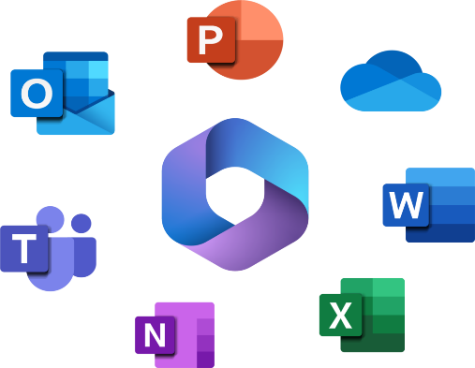

Basic Computing & Microsoft 365
1 Year Diploma & Certificate Programs Foundation

Slide 2
Learning Objectives
After this lesson, students will be learn and know;
The difference between MS 365 and the Microsoft Office Suite.
What Operating System (OS) is Compatible with MS 365
The main hardware devices
Correct order to switch on devices
Correct order to switch off devices

Slide 3
1.Basic Computing

Slide 4
Three Parts of Basic Computing
Setting up the Hardware
The Correct Order to switch on
The correct order to switch off

Slide 5
1. Setting up the Hardware
System Unit
Monitor
UPS (Uninterrupted Power Supply)
Printer
Socket Switch
Analogy
The System Unit is the brain
The monitor is the face
The UPS is the Heart/Power Source
The cables are like nerves

Slide 6
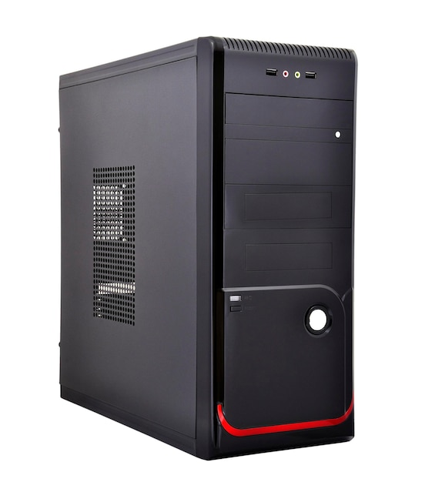
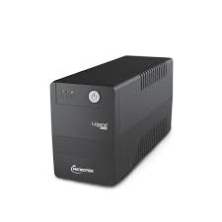
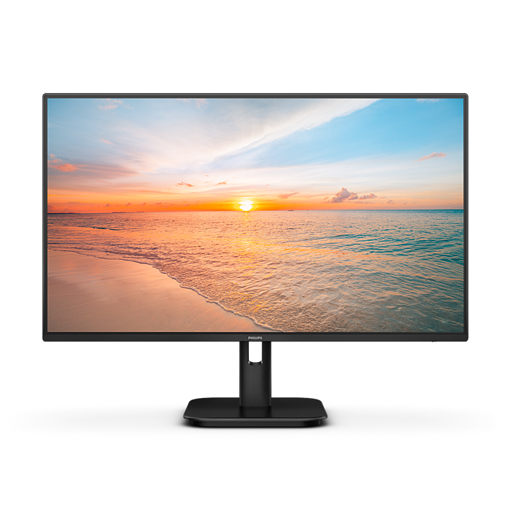
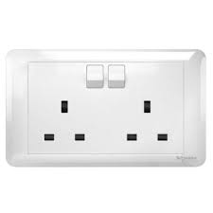
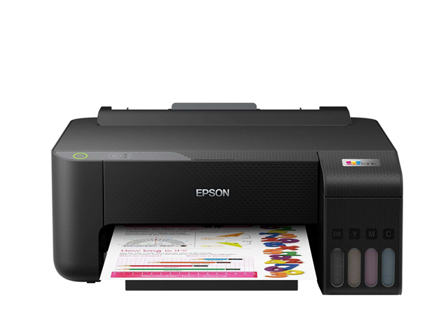
2. The Correct Order to Switch on Devices
Socket Switch
UPS
Monitor
System Unit
Printer

Slide 7
3. The Correct Order to Switch off Devices
Printer
System Unit
Monitor
UPS
Socket Switch
The GOLDEN Rule
Start from the power source and move out to the devices. This is like turning on the main water valve before you open a tap.

Slide 8
2.Microsoft 365

Slide 9
What is the difference between the MS365 and Microsoft Office Suite?
It is a cloud based subscription service from Microsoft. It is more than just apps, it is a complete ,integrated productivity platform. When you subscribe then you can use it.
In short: Microsoft 365 = Office Apps + Cloud Services + Collaboration tools + continuous updates (via subscription)
This traditionally refers to a one time purchase of the software suite. You pay the cost of buying the specific version of the software but you don’t receive new feature updates, and it does not include clud services and if new major versions comes out you have to pay for the full price to get its latest features.

Slide 10
Operating System Compatible for MS65
Windows 11 is fully compatible with Microsoft 365 (formerly Office 365). The desktop versions of Word, Excel, PowerPoint, and Outlook are designed to work seamlessly on Windows 11, including both 32-bit and 64-bit installations. Users can install and run these apps directly on the OS.

Slide 11
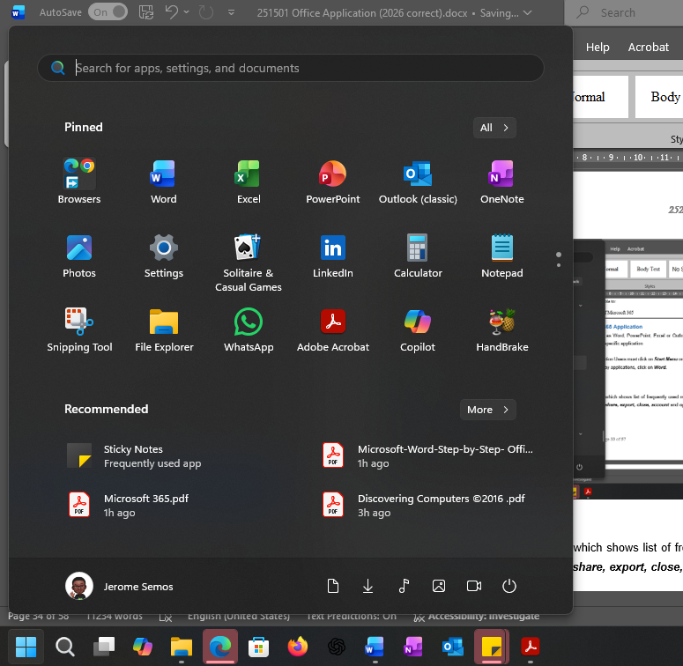
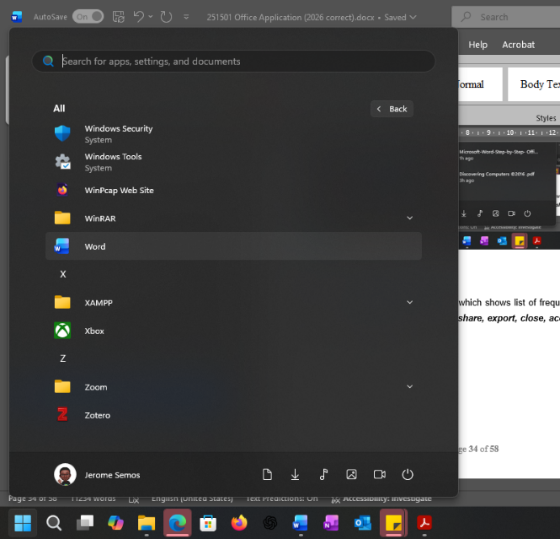
Starting a Microsoft 365 Application
For all Microsoft 365 applications such as Word, PowerPoint, Excel or Outlook the user must first launch it by opening the specific application on their computer.
For example, to open Word office application Users must click on Start Menu on the Task bar, then click on All Programs to display applications, and click on Word.
Figure 5.8: shows how to start the Microsoft 365 Application

Slide 12
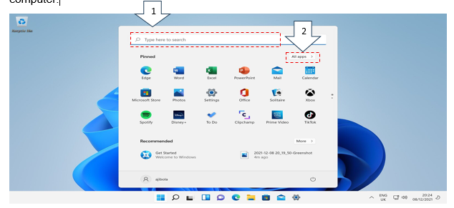
Locating Applications
Two methods of locating applications.
Use the Start Menu or Search Bar to find apps.
Inside the start menu click the All-Apps list to show everything installed on the computer
Figure 5.4: Windows 11 locating applications
Prepared: by: MS Odilia Tita

Slide 13
Thank you !!

Slide 14
Introduction
Chapter 1

Slide 15
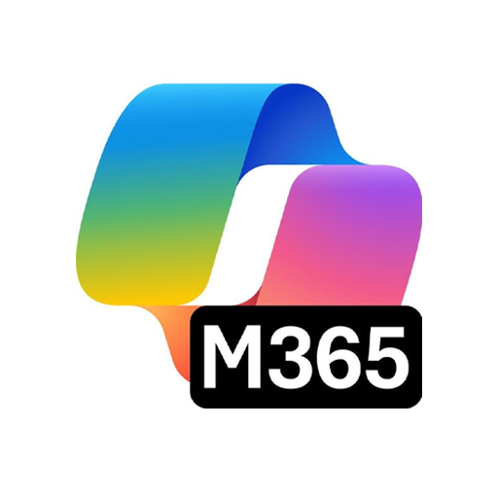
LEARNING OUTCOMES
By the end of this session, students should be able to;
  Evolution of Computer
  Computer Definition
  Social Effects of Computer

Slide 16
INTRODUCTION TO MICROSOFT OFFICE 365
This chapter briefly explains the following;
The evolution of Computers some 200 years back in the 19th century.
The five generations of computers which brings light on how the computer was initially developed and used.
The advantages and disadvantages of each generation of Computer.
  The use of computer has many positive impacts in both personal and business environment.

Slide 17
Evolution of Computers
From the primitive era to the digital era, computers have changed the way we interact and do things at home, education, businesses and almost in our daily lives.
Computers today comes in the form of personal desktop computers, laptops and tablets have become such an important part of everyday living that it can be difficult to remember a time when they did not exist. In reality, computers as they are known and used today are still relatively new. Although computers have technically been in use since the abacus approximately 5000 years ago, it is modern computers that have had the greatest and most profound effect on society. The first full-sized digital computer in history was developed in 1944 called the Mark I, this computer was used only for calculations and weighed five tons. Despite its size and limited ability, it was the first of many that would start off generations of computer development and growth as discussed below:

Slide 18
Evolution of Computers
First Generation of Computers (Vacuum tube): 1940 - 1956
Second Generation of Computers (Transistor): 1956 - 1963
Third Generation Computers (Integrated Circuit(IC):1964-1971
Fourth Generation Computers (Microprocessor): 1971-2010
Fifth Generation Computers (AI): Present and Beyond

Slide 19
1. First Generation of Computers (Vacuum Tube)
First generation computers bore little resemblance to computers of today, either in appearance or performance. The first generation of computers took place from 1940 to 1956 and was extremely large in size. The inner workings of the computers at that time were unsophisticated. These early machines required magnetic drums for memory and vacuum tubes that worked as switches and amplifiers. It was the vacuum tubes that were mainly responsible for the large size of the machines and the massive amounts of heat that they released. These computers produced so much heat that they regularly overheated despite large cooling units. First generation computers also used a very basic programming language that is referred to as machine language. Fig 1.1 shows Vacuum Tubes.

Slide 20
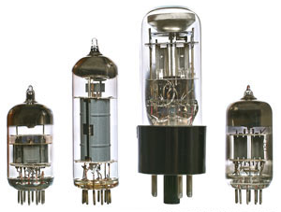
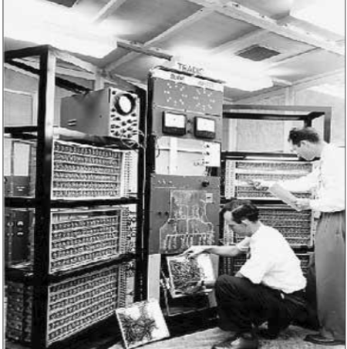
First Generation of Computers (Vacuum Tube)
These are examples of first generation of computer:
ENIAC
EDVAC
UNIVAC
IBM-701
IBM-650
Fig 1.1 showing different vacuum tubes using in ENIAC

Slide 21
First Generation of Computers (Vacuum Tube) Advantages & Disadvantages
Advantages:
It made use of vacuum tubes which are the only electronic component available during those days.
These computers could calculate in milliseconds.
Disadvantages:
These were very big in size; weight was about 30 tones.
These computers were based on vacuum tubes.
These computers were very costly.
It could store only a small amount of information due to the presence of magnetic drums.
As the invention of first-generation computers involves vacuum tubes, so another disadvantage of these computers was, vacuum tubes require a large cooling system.
Very less work efficiency.
Limited programming capabilities and punch cards were used to take inputs.
Large amount of energy consumption.
Not reliable and constant maintenance is required

Slide 22
1. Second Generation of Computers (Transistor)
The second generation (from 1956 to 1963) of computers managed to do away with vacuum tubes in lieu of transistors. This allowed them to use less electricity and generate less heat. Second generation computers were also significantly faster than their predecessors. Another significant change was in the size of the computers, which were smaller. Transistor computers also developed core memory which they used alongside magnetic storage. Fig 1.2 shows Transistors.

Slide 23

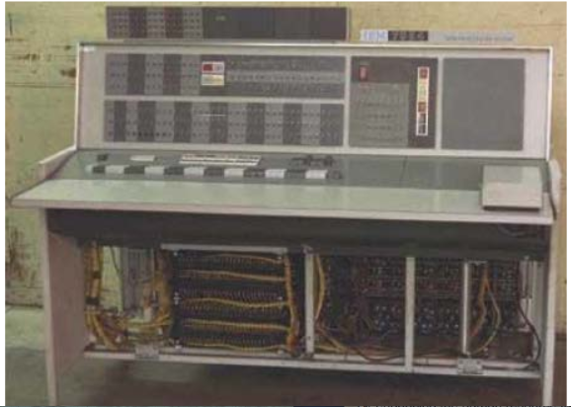
Second Generation of Computers (Transistor)
Below are examples of second generation of computer:
Honeywell 400
IBM 7094
CDC 1604
CDC 3600
UNIVAC 1108
Fig 1.2 showing different transistors

Slide 24
Second Generation of Computers (Transistor) Advantages & Disadvantages
Advantages:
Due to the presence of transistors instead of vacuum tubes, the size of electron component decreased. This resulted in reducing the size of a computer as compared to first generation computers.
Less energy and not produce as much heat as the first generation.
Assembly language and punch cards were used for input.
Low cost than first generation computers.
Better speed, calculate data in microseconds.
Better portability as compared to first generation
Disadvantages:
A cooling system was required.
Constant maintenance was required.
Only used for specific purposes.

Slide 25
3. Third Generation of Computers (Transistor)
From 1964 to 1971 computers went through a significant change in terms of speed, courtesy of integrated circuits. Integrated circuits, or semiconductor chips, were large numbers of miniature transistors packed on silicon chips. This not only increased the speed of computers but also made them smaller, more powerful, and less expensive. In addition, instead of the punch cards and the printouts of previous systems, keyboards and monitors were now allowing people to interact with computing machines. Fig 1.3a shows Integrated Circuits with different sizes.

Slide 26
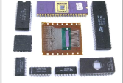
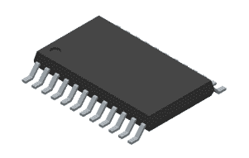
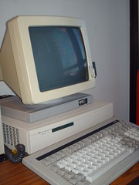
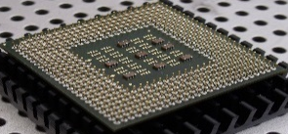
Third Generation of Computers (Integrated Circuit-IC)
These are examples of third generation of computer:
PDP-8
PDP-11
ICL 2900
IBM 360
IBM 370
Fig 1.3a showing structural view of integrated circuit (IC) with different sizes.
A single modern CPU can have millions or even billions of transistors as shown below in Fig 1.4
Fig 1.4 below showing CPU with IC.

Slide 27
Third Generation of Computers (Integrated Circuit) Advantages & Disadvantages
Advantages:
These computers were cheaper as compared to second-generation computers.
They were fast and reliable.
Use of IC in the computer provides the small size of the computer.
IC not only reduce the size of the computer but it also improves the performance of the computer as compared to previous computers.
This generation of computers has big storage capacity.
Instead of punch cards, mouse and keyboard are used for input.
They used an operating system for better resource management and used the concept of time-sharing and multiple programming.
These computers reduce the computational time from microseconds to nanoseconds

Slide 28
Third Generation of Computers (Integrated Circuit) Advantages & Disadvantages
Disadvantages:
IC chips are difficult to maintain.
The highly sophisticated technology required for the manufacturing of IC chips.
Air conditioning is required.

Slide 29
4. Fourth Generation of Computers (Microprocessor)
The changes with the greatest impact occurred in the years from 1971 to 2010. During this time technology developed to a point where manufacturers could place millions of transistors on a single circuit chip. This was called monolithic integrated circuit technology. It also heralded the invention of the Intel 4004 chip which was the first microprocessor to become commercially available in 1971. This invention led to the dawn of the personal computer industry. By the mid-70s, personal computers such as the Altair 8800 became available to the public in the form of kits and required assembly. By the late 70s and early 80s assembled personal computers for home use, such as the Commodore Pet, Apple II and the first IBM computer, were making their way onto the market. Personal computers and their ability to create networks eventually would lead to the Internet in the early 1990s. The fourth generation of computers also saw the creation of even smaller computers including laptops and hand-held devices. Graphical user interface, or GUI, was also invented during this time. Computer memory and storage also went through major improvements, with an increase in storage capacity and speed. Fig 1.5 shows Microprocessor

Slide 30
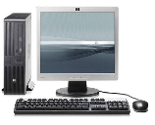

Fourth Generation of Computers (Microprocessor)
These are few examples fourth generation computer:
IBM 4341
DEC 10
STAR 1000
PUP 11
Fig 1.5 showing microprocessor used in PCs and Laptops.

Slide 31
Fourth Generation of Computers (Microprocessor) Advantages & Disadvantages
Advantages:
Fastest in computation and size get reduced as compared to the previous generation of computer.
Heat generated is negligible.
Small in size as compared to previous generation computers.
Less maintenance is required.
All types of high-level language can be used in this type of computers.
Disadvantages:
The Microprocessor design and fabrication are very complex.
Air conditioning is required in many cases due to the presence of ICs.
Advance technology is required to make the ICs.

Slide 32
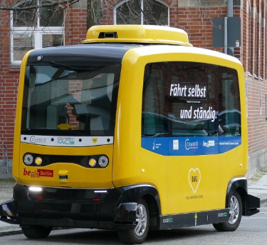
5. Fifth Generation of Computers (Artificial Intelligence(AI))-Present & Beyond
Fifth generations computing devices is based on artificial intelligence (AI) are still in development, although there are some applications such as voice recognition, facial face detector, and thumb print that are used today. In the future, computer users can expect even faster and more advanced computer technology. Computers continue to develop into advanced forms of technology in the field of nanotechnology, artificial intelligent, as well as quantum computation. AI is a field of science which is developed to make computer think and act like a human being. Fig 1.6 shows self-driving car that uses censors to identify traffic signals, crossings, etc.
These are some examples.
PCs of Pentium
Ultra Book
Note Book
Chrome Book
Supercomputers with PARAM
Fig 1.6 showing self-driving car

Slide 33
Fifth Generation of Computers (AI)-Present & Beyond Advantages & Disadvantages
Advantages:
The ability to understand human language.
The ability to recognize graphs and images.
The ability to self-organize itself.
Self-learning abilities.
Parallel processing and more CPU cores mean more speed.
Thinking more logically resulting in taking wiser decisions on its own to solve everyday problems.
Disadvantages:
AI is great but people think that it will replace their jobs in the future, that’s somehow true but it’s this is how the world works, people shouldn’t be afraid of evolving or adapting to the new technologies
They may make the human brains dull and doomed

Slide 34
Computer Definition
Computers have changed the way of life people do things. Multiple tasks can be done easily and faster easing the burden of time consuming when not using computer technology. Today, computers are used almost in every aspects of interactions, for example, banks, hospitals, schools, businesses, etc. You can use computer to type letters, develop business documents, use internet for various reasons, for example, online buying and selling of products and services (e-commerce), do research, education, playing games, social networking, phone banking etc. Seeing all these changes computer has brought about, it is considered as one of the greatest inventions of the 1st century.
Before 1935, a computer was a person who performed arithmetic calculations. Between 1935 and 1945 the definition referred to a machine, rather than a person. The modern machine definition is based on von Neumann's concepts: a device that accepts input, processes data, stores data, and produces output.
We have gone from the vacuum tube to the transistor, to the microchip. Then the microchip started talking to the modem. Now we exchange text, sound, photos and movies in a digital environment.
Computer is a programmable machine that response to instructions (input data), execute the instructions (process), the store data and print it (output). Computer operate according to how it is programed.

Slide 35
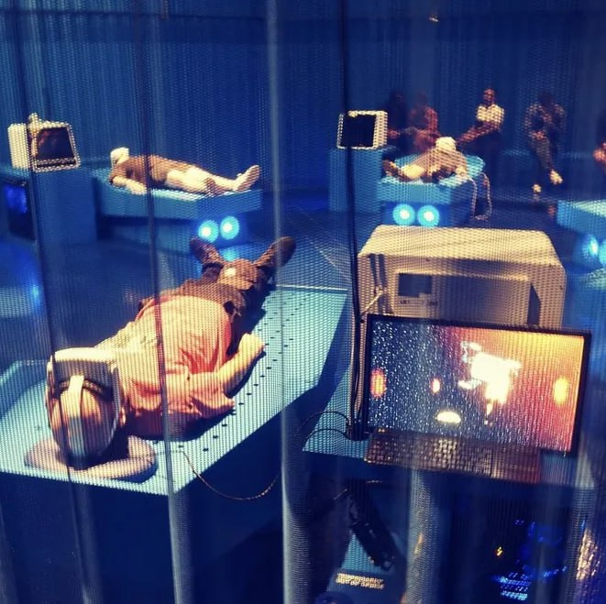
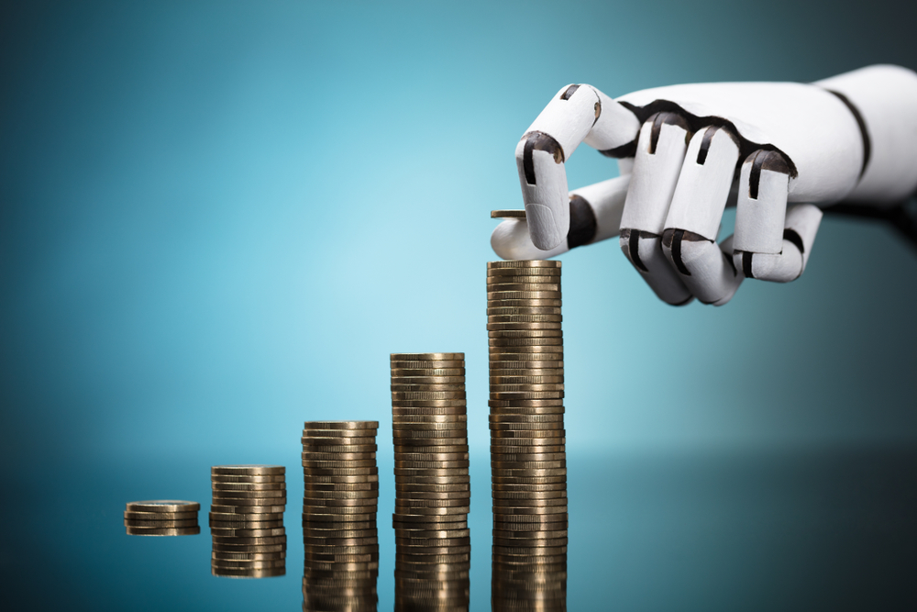
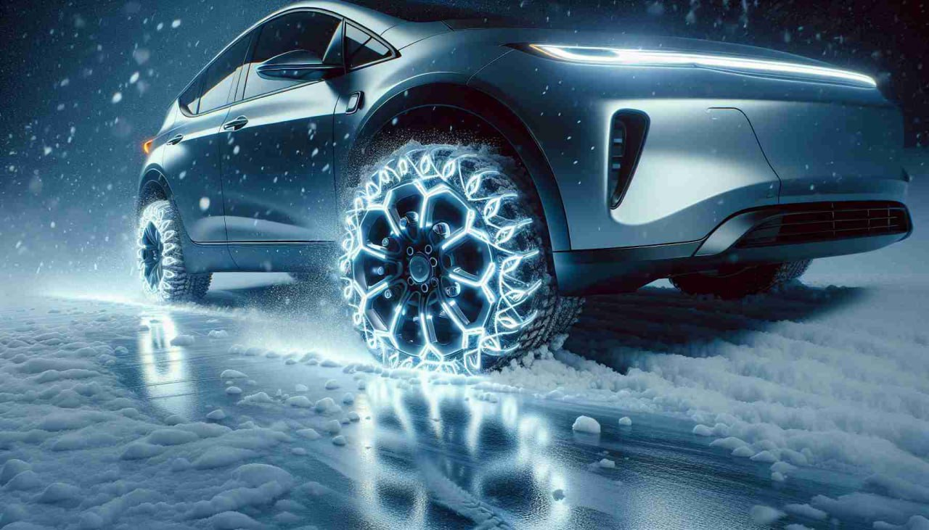
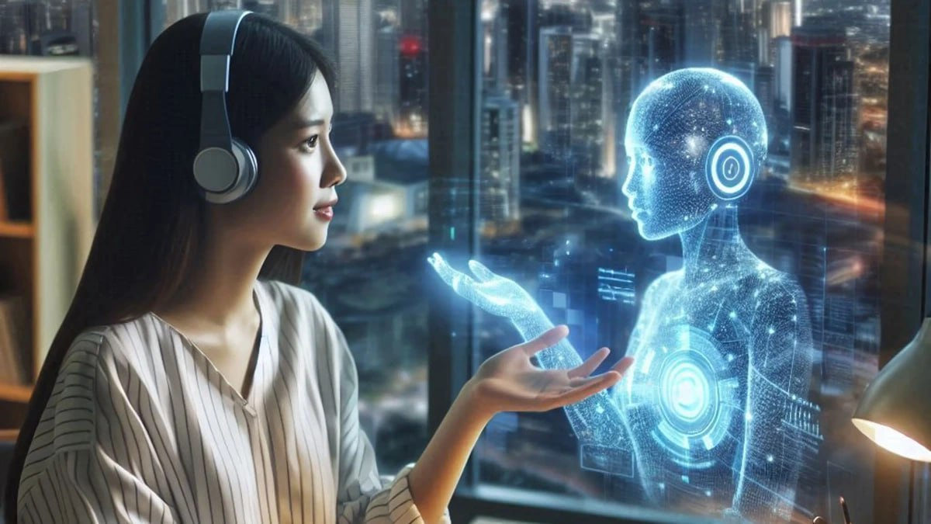
Social Effects of Computers
The Social Impact of Computers should be read as a guide to the social implications of current and future applications of computers. Below are few examples of the use of Computer in different fields.
Science
Education
Communication
Engineering and Manufacturing
Banking
Health Care
Business and Industries

Slide 36
Positive Impacts of using a Computer
Any professional individual like doctors, engineers, businessmen etc. undergo a change in their style or working pattern after they get the knowledge of computer.
An individual becomes more competent to take a decision due to the computer because all the information required to take the decision is provided by the computer on time. As a result, any individuals or institutions get success very fast.
The person working at the managerial level becomes less dependent on low level staff like clerks and accountants. Their accessibility to the information increases tremendously. This improves their working patters and efficiency, which benefit the organization and ultimately affects the society positively.
In common life also, an individual gets benefited with computer technology. When airports, hospitals, banks, departmental stores have been computerized, people get quick service due to the computer system.
Computers have created new fields of employment. These employments are in the field of designing, manufacturing, teaching etc.

Slide 37
Examples of Positive Impacts of using a Computer
Increased Productivity and efficiency
Enhance Communication
Information Accessibility and Education
Entertainment and Convenience
Data Storage and Management
Business and Financial Management
Medical and Healthcare Advancement
Innovation and Creativity
Remote Work Collaboration
Environmental Benefits

Slide 38
Negative Impacts of using a Computer
Due to any reasons, if the data stored in the computer is lost, the person responsible for handling the computer will have to tolerate a lot.
People do not use their mind for common arithmetic, which gradually results in loss of their numerical ability.
Today, any person who does not have the knowledge of computer is considered the second-class citizens.
People have fear that growing children may lose their common sense abilities like numerical ability due to total dependence on computers.
Due to the computerization workload for the employees reduces many times. As a result, many organizations may require removing some of its employees. It produces the dissatisfaction and lack of security among the employees. Due to this, employees do not corporate with the organization. As a result, the output can be disastrous.
As a result of introduction of new technology in an organization, the organization may need to spend a tremendous amount on the training of its employees.

Slide 39
Examples of Negative Impacts of using a Computer
Negative effect on Physical Heath (Eye Strain, Repetitive Strain Injury (RSI), Poor Posture, Vision Problem, Computer Vision Syndrome(CVS) and Obesity)
Children Exposure to Adult Material
Sleeping Problems
Exposure to Radiation
Security & Privacy Risks
Environmental Impacts
Social and Psychological effects
Job Displacement
Loss of Skills
Plagiarism & Distraction
Addiction & Distraction
Exposure to Radiation

Slide 40
Summary
First Generation – vacuum tubes (1940 – 1956)
Examples: ENIAC, UNIVAC, etc.
Second Generation – transistors (1956 – 1963)
Examples: IBM 7090, UNIVAC 1107, etc.
Third Generation – integrated circuits (1964 – 1971)
Examples: IBM System /360, UNIVAC 1108 etc.
Fourth Generation - microprocessors (1971 – 2010)
Examples: Apple II, IBM PC, Apple Macintosh, etc.
Fifth Generation: Artificial Intelligence (AI) and Quantum Computing
Examples: Self-driving car, chess-playing computers, etc.

Slide 41
Computer is an advanced electronic device that takes raw data as input from the use and processes it under the control of a set of instructions (called program), produces a result (output), and saves it for future use.
Social effects of computer:
Uses of computer Science
Uses of computer in Education
Uses of computer in Communication
Uses of computer in Engineering and Manufacturing
Uses of computer in Banking Industries
Uses of computer in Health Sector

Slide 42
Positive Impacts
  Improve work productivity
  Access of information on fingertip
  Job creation
Negative Impacts:
  Effects on physical health
  Exposure to adult material
  Vision problems
  Poor exposure
  Sleep problems
  Exposure to radiation

Slide 43
Review Activities:
Define what a computer is with the processes involved.
Name and explain with examples the five generation of computers
Provide some examples relating to the use of computer.
Give three examples each for the positive and negative effects on using the computer.

Slide 44
Thank you !!

